Slide 1
Welcome to all
for the MHRM Online lecture
By
Mr. Dhiraj Ovhal
HOD of Commerce

Slide 2
Chapter -2
Marketing Decision –I
(Product and Price)

Slide 3
Q.7 What do you mean by Pricing and Explain the Objectives ?
Meaning:-
Price means exchange value of products. Seller is ready to sell and buyer is ready to accept at agreed price. the marketer should keep right price as per the competitors price strategy. It should not keep high price because no one like to purchase with high price and low price create doubt about quality of the products.
( Exchange value... No high or low price Right price..)
( Penetration price means low price and Skimming price means High price)

Slide 4
Factors influencing/affecting /determining of Pricing? :-
 | Internal Factors | External Factors
1 | Cost | Competition
2 | Corporate Image | Consumers
3 | Objectives of the Firm | Demand
4 | Product | Economic condition
5 | Product Life Cycle | Financial Incentives
6 | Other internal factors | Other external Factors

Slide 5
1 . Survival
2.Profit
3.Sales
4.Competation
5.Customer satisfaction
6.Skimmimg pricing
7.Pentration pricing
8.Social responsibility
-Objectives :-

Slide 6
1 . Skimming pricing
2. Penetration Pricing
3. Standard pricing
4. Probe Pricing
5. Differential trade margin pricing strategy
6. Different price for different market or customer
7. Trial Price
8. Follow the leader pricing strategy
9. Flexible pricing
Pricing Strategy :

Slide 7
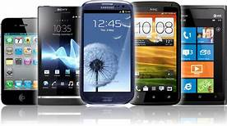
Skimming pricing:- (High Price)
high price to recover early profit i.e. Technology products, fashionable products, etc.

Slide 8
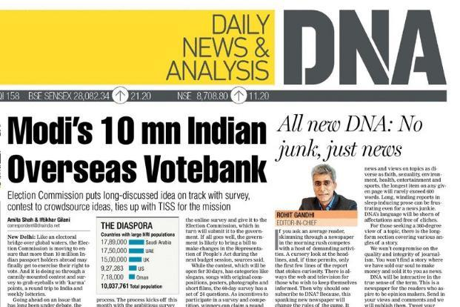
2. Penetration Pricing :-
Low price to attract and expand the market ( for ex. DNA newspaper was early distributed free of cost, then 1 rupess,2 rupees, and now as price as per times of India.

Slide 9
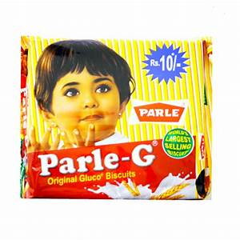
3. Standard Pricing :-
Fix price to Rural and Urban Market i.e Cello ball pen rs.5
Parle G

Slide 10
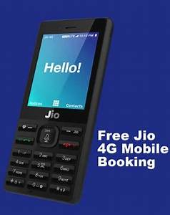
4. Probe Pricing:-
First keep high price, if customer accept - no problem otherwise reduce or low price..It is called probe or investigate price.

Slide 11
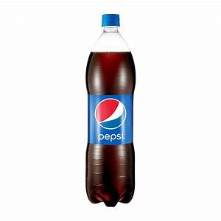
5. Differential trade margin pricing strategy:-
like wholesaler commission, retailer commission may increase the price of the product .
Pepsi:--- Normal Shop :- 15 rupees
Cine Max
Popcorn :- Railway Station & Cine Max

Slide 12
6. Different price for different market or customer:-
Alphanso mango at Konkan and Mumbai is totally different price .

Slide 13
7. Trial Price:-
Keep low price to attract afterwards increase the price- Jio Sim

Slide 14
8. Follow the leader pricing strategy:-
Jio price now follow all NETWORK like Airtel,Vodaphone,

Slide 15
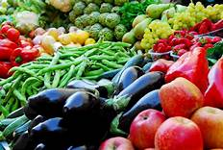
9. Flexible pricing:-
different price on various time at morning ,afternoon ,night etc.

Slide 16
1 . Skimming pricing
2. Penetration Pricing
3. Standard pricing
4. Probe Pricing
5. Differential trade margin pricing strategy
6. Different price for different market or customer
7. Trial Price
8. Follow the leader pricing strategy
9. Flexible pricing
Pricing Strategy :

Slide 17
Thank You

Slide 18
Attendance Link
https://forms.gle/Xqvykv5vfEi1zpyF7
(Mention date at last point)

